Slide 1
The Inclusive Therapist: How to Impact more Children with Gross Motor Difficulties using Whole School Interventions Faith Newton, MSc, BA (Hons)
@FaithSchoolOT

Slide 2
Content
Gross Motor Difficulties
Opportunities for OTs
Interventions
Impact
The Inclusive School Series

Slide 3
Gross Motor difficulties can lead to...
Poor FM skills and writing
Less participation at playtimes & social isolation
Getting into trouble & low self-esteem
School avoidance
Not enjoying PE & avoiding physical activity
‘PE is a living hell for my child’
‘PE has seriously scarred me for life and I loathe doing exercise’

Slide 4
Models of Provision
Specialist | Whole School Approach / Universal
Focused on Individual | Focused on Class / School
Condition Based | Needs Based
Improving skills of child | Adapting environment
Bottom Up | Top Down
Pull out model | Integrated
Little up-skilling teachers | Sharing practice & up-skilling

Slide 5
WSA: Opportunities for OTs
Curriculum Planning & Teaching
School Environment
Policies & Practice
Staff Development
Student Voice
Family Engagement
Vision & Values
Notes:
Curriculum Planning & Teaching:
Emphasizing foundational skills that need to be in place
Training staff on progression of GM skills e.g. jumping before hopping, teaching balls skills
How to adapt PE activities
How to make learning more active
How to think about learning positions
School Environment
Audit of playground
Looking at PE and playtime resources and recommending equipment to buy / use differently
Arrangement of furniture in class and flexible seating to maximise opportunities for movement
Sensory audit
Staff Development
Formal and informal training around movement, movement breaks, flexible seating, adapting activities, developing skills

Slide 6
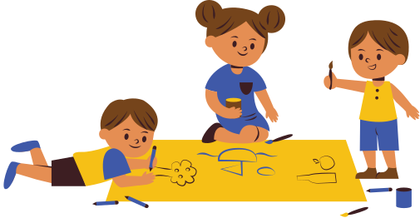
Interventions
Embedding Movement in Class
Movement Breaks & Movement Stations
Flexible seating and classroom layout
P.E
Adapting activities
Progression stages of PE curriculum
Looking at barriers & making more inclusive
Playtimes
Active groups and Activity Stations
Playground redesign
Staff Training

Slide 7
Impact
Children enjoyed attending Active Group
Children are engaging in more active play
Opportunities for girls to play football
Number of injuries have decreased
Children’s skills have developed
Staff are more confident in teaching PE
Regular class movement breaks - less difficulties with movement seeking

Slide 8
The PE Premium
The PE Premium (£16 000 +) can be used to:
Engage the least active children
Encourage active play during break and lunchtimes
Encourage pupils to take on sports leadership
Embed physical activity
Develop teacher’s confidence, knowledge and skills in teaching PE to all pupils
Notes:
Schools recieve £16,000 plus £10 per pupil

Slide 9
Free Resource faith@schoolot.co.uk

Slide 10
References & Resources
https://www.aota.org/-/media/Corporate/Files/Practice/Children/SchoolMHToolkit/Recess%20Promotion.pdf
Department for Education. (2019) School Support Activity & Action Plan https://assets.publishing.service.gov.uk/government/uploads/system/uploads/attachment_data/file/848082/School_sport_and_activity_action_plan.pdf
Dyspraxia Foundation. https://dyspraxiafoundation.org.uk
https://everymomentcounts.org/refreshing-recess
Hinder E and Ashburner J (2017) Occupation Centred Intervention in the School Setting. In: Rodgers S, Kennedy-Behr A, ed. Occupation-Centred Practice with Children: A Practical Guide for Occupational Therapists (2nd Edition). Chichester, West Sussex: John Wiley & Sons 233-256
NHS Digital. (2020) National Child Measurement Programme (2019-20), Population Health Team. https://digital.nhs.uk/data-and-information/publications/statistical/national-child-measurement-programme/2019-20-school-year
Royal College of Occupational Therapists (2019) Occupational Therapy: Unlocking the potential of Children and Young People. London: RCOT
Schaaf, R. And Miller, L. (2005). Occupational Therapy using a sensory integrative approach for children with developmental disabilities. Mental Retardation and Developmental Disabilities Research Reviews 11: 143–148
Sport England. (2021) Active Lives Children and Young People Survey Coronavirus (Covid-19) Report. Mid-May to late-July 2020 (the summer term). https://www.sportengland.org/know-your-audience/data/active-lives

